Slide 1
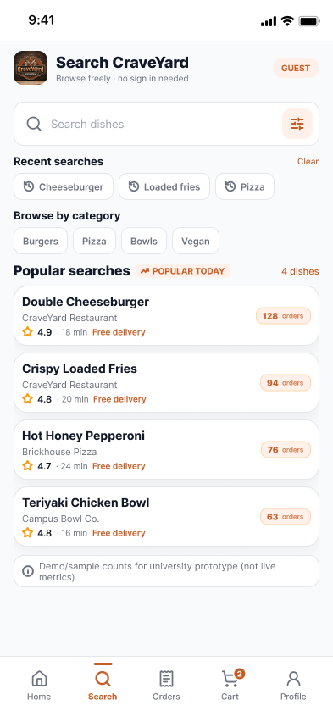
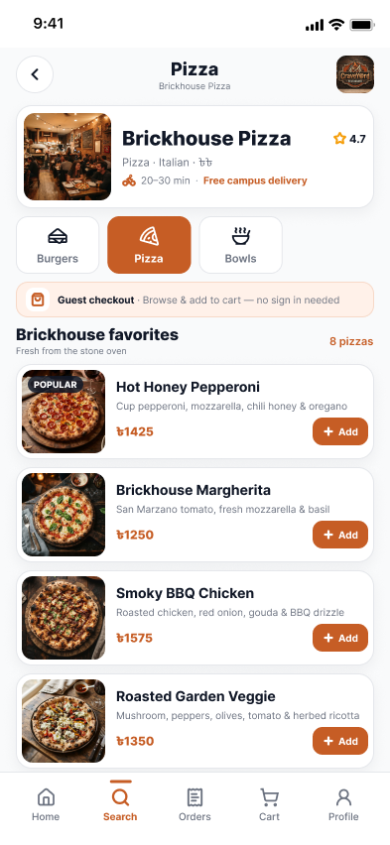
PART 2 • FUYAD
Discovery, search and restaurant menu
Students start from a campus-aware search screen and land on a menu built for quick ordering.
Campus-first search
Search CraveYard with no sign-in needed. Recent searches sit under the field so repeat orders are one tap away.
Browse by category
Burgers, Pizza, Bowls, Vegan and Non-Veg chips filter the list instantly.
Popular today
Dishes show ratings, free-delivery tags and sample order counts to help students pick quickly.
Menu at a glance
The restaurant page shows rating, 20–30 min delivery, a favourites list with prices and a quick Add button.
USER OUTCOME Find a dish and open its menu in a few taps.
SEARCH
RESTAURANT MENU
Notes:
Search is open to guests, so nobody has to register just to look around. Category chips and popular searches shorten the path to a dish. Opening a restaurant shows its rating, delivery time and favourites with a quick Add button. Order counts are sample data for the prototype.

Slide 2
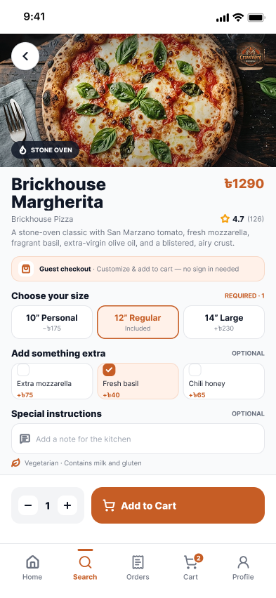
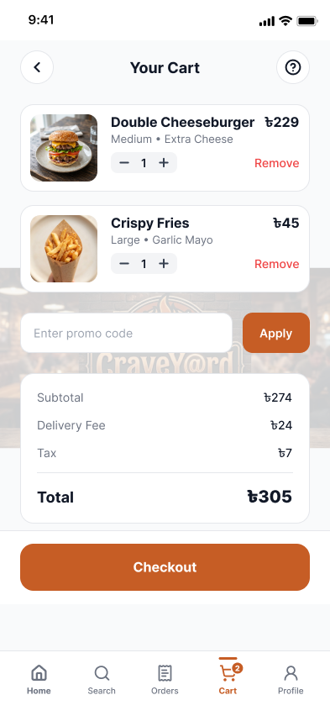
PART 2 • FUYAD
Item customization and cart
Students shape the dish in a bottom sheet, then review a transparent cart before checkout.
Choose a size
Size options such as 10", 12" and 14" are required, so every order has a clear portion.
Optional extras and notes
Add-ons like extra mozzarella, fresh basil or chili honey are tickable, with a note field for the kitchen.
Quantity steppers
The cart has + and − controls and a Remove link, so changes need no extra screens.
Clear costs
Subtotal ৳274, delivery ৳24 and tax ৳7 add up to ৳305, with a promo code field above the total.
USER OUTCOME No surprises: students see choices and costs before paying.
ITEM OPTIONS
YOUR CART
Notes:
On the item sheet the size is required and extras are optional. Add to Cart carries the choice into the cart, where quantities can be changed and the bill is itemised: 274 plus 24 plus 7 gives 305 taka. The promo code field sits right above the total.

Slide 3
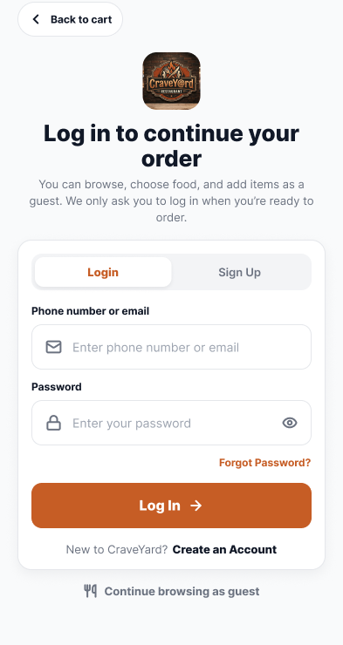
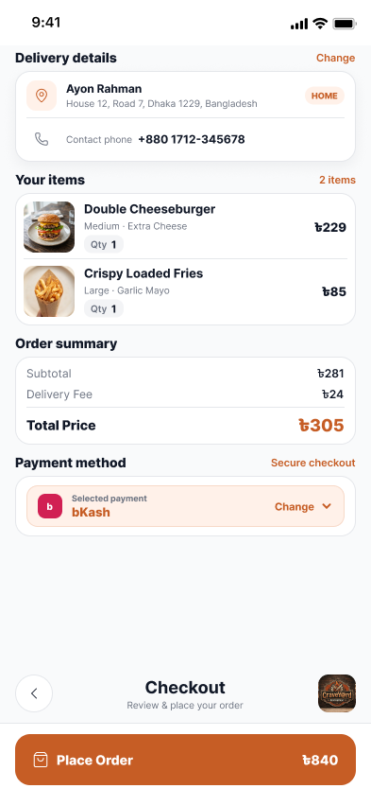
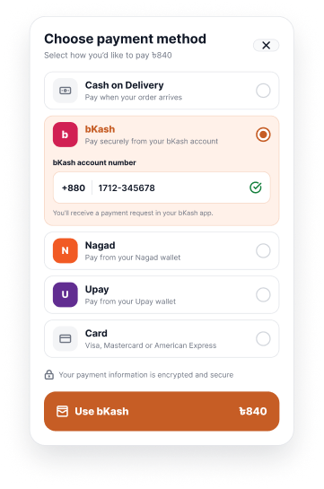
PART 2 • FUYAD
Sign in, checkout and payment
Checkout asks for an account only at the last moment and supports the payment options students actually use.
Guest option
The login gate lets students log in, sign up or continue browsing as a guest.
Delivery and summary
Checkout shows the saved address, contact phone, items and price summary on one screen.
Local payment methods
Cash on Delivery, bKash, Nagad, Upay and Card are listed in one sheet.
bKash number entry
Choosing bKash reveals a number field and a payment request note before the pay button.
PAYMENT
USER OUTCOME Quick checkout, local payments.
LOGIN OR GUEST
CHECKOUT
Notes:
Account creation is deferred to the point it is needed, and guests can keep browsing. Checkout gathers address, contact and summary. The payment sheet offers cash, bKash, Nagad, Upay and card; selecting bKash asks for the account number. Amounts differ between screens because these are prototype frames.

Slide 4
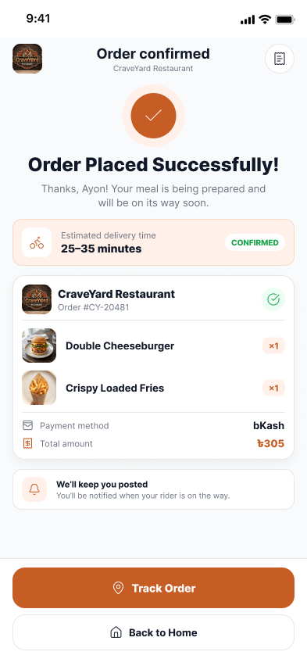
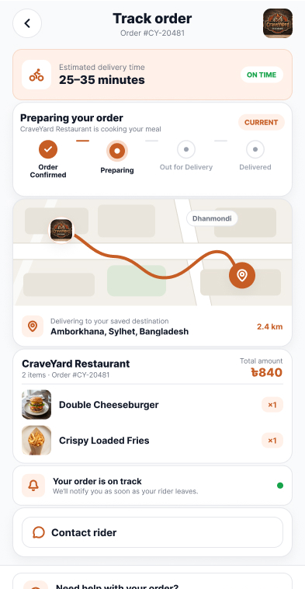
PART 2 • FUYAD
Order confirmation and tracking
After paying, students get a receipt-style confirmation and a live view of the order.
Confirmation screen
Order Placed Successfully shows the estimated 25–35 min delivery time and the ordered items.
Progress stages
Order Confirmed, Preparing, Out for Delivery and Delivered show where the order is.
Route and distance
A map shows the courier route to the saved destination with a distance of 2.4 km.
Help in one tap
Track Order, Contact rider and a help link are on the same screens.
USER OUTCOME Students always know what happens next.
CONFIRMATION
TRACKING
Notes:
The confirmation screen reassures the student that the order is placed and gives a delivery estimate. Tracking breaks the order into four stages, adds a route map and distance, and keeps contact buttons close by.

Slide 5
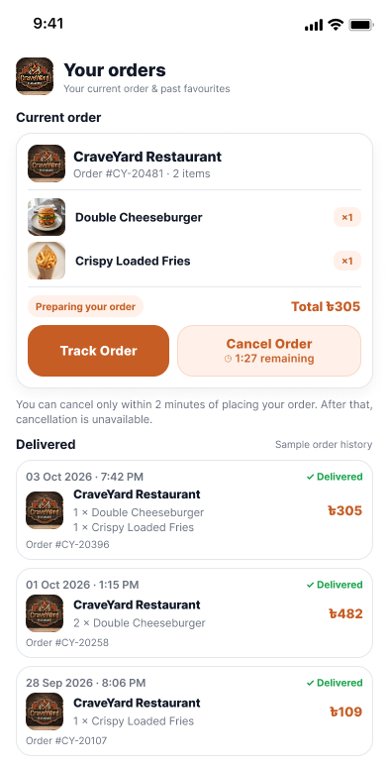
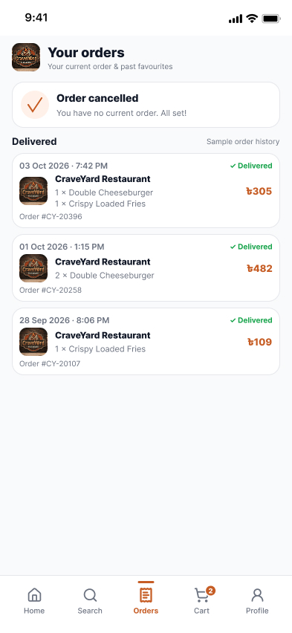
PART 2 • FUYAD
Cancellation window and order history
A short safety window covers accidental orders, and past orders stay easy to review.
2-minute cancel window
The current order shows a Cancel Order button with a countdown (1:27 remaining in the prototype).
Clear limit
A note explains that cancelling is only possible within 2 minutes of placing the order.
Cancelled state
A confirmation banner says the order is cancelled and there is no current order.
Order history
Delivered orders list restaurant, items, date and total so students can review past purchases.
USER OUTCOME Fast mistakes are fixable, and the rules are clear.
CURRENT ORDER
ORDER CANCELLED
Notes:
Right after ordering, the Orders tab shows Track Order and Cancel Order with a countdown. The note explains the 2-minute limit. Once cancelled, the screen confirms it, and the history below lists earlier delivered orders.

Slide 6
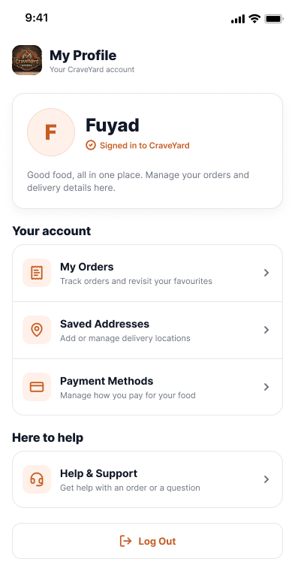
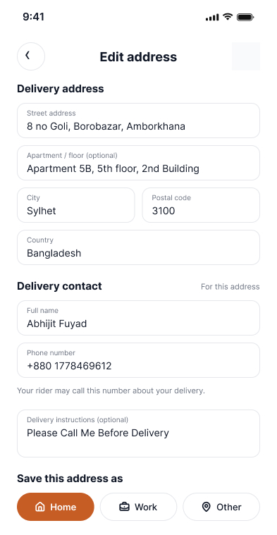
PART 2 • FUYAD
Profile and saved addresses
Account screens keep repeat orders quick for students who order often.
Account hub
My Profile links to My Orders, Saved Addresses, Payment Methods and Help & Support, plus Log Out.
Signed-in identity
A profile card shows the account name and signed-in status.
Detailed address form
Street, apartment, city, postal code and country, plus a delivery contact name and phone.
Save as Home, Work or Other
Tags and delivery instructions are saved so the next checkout starts filled in.
USER OUTCOME Repeat orders start with details already filled in.
MY PROFILE
EDIT ADDRESS
Notes:
The profile is the hub for orders, addresses, payments and help. The address form collects everything a courier needs, including a contact number and delivery note, and can be saved as Home, Work or Other.

Slide 7
CRAVEYARD • TEAM FIGMA PROJECT
Thank you
Questions and discussion
Abhijit Das Ayon
0182420012101038
Md Habibur Rahman Fuyad
0182420012101032
Design approach • App functionality • Interactive prototype

Slide 8
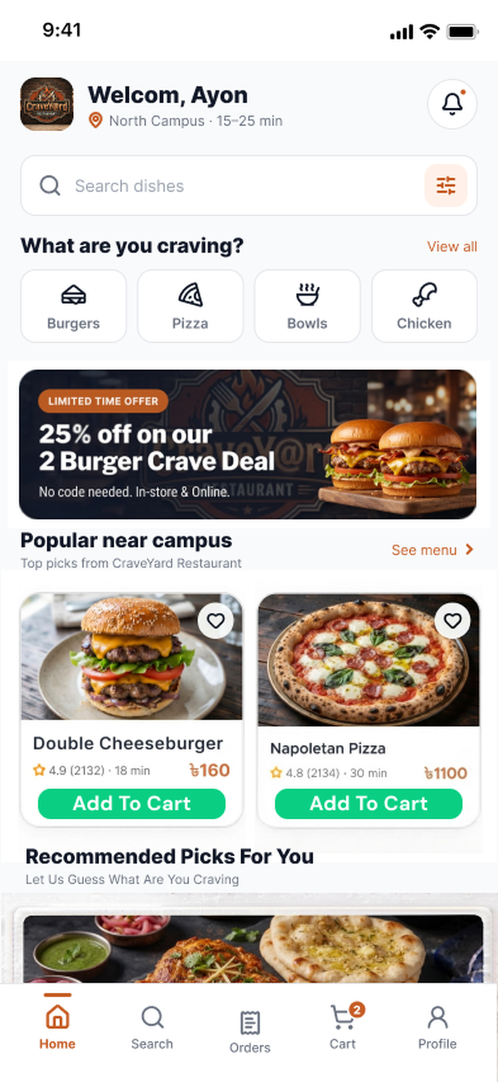



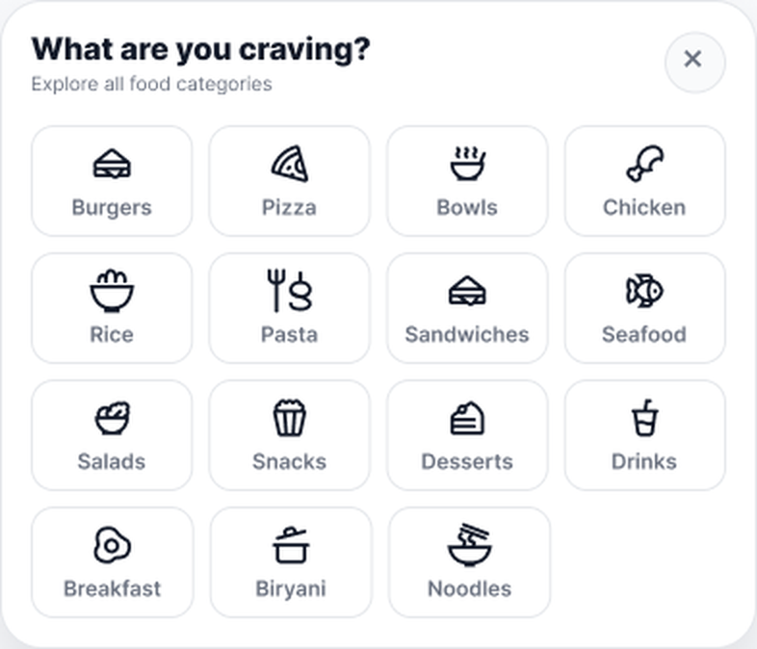
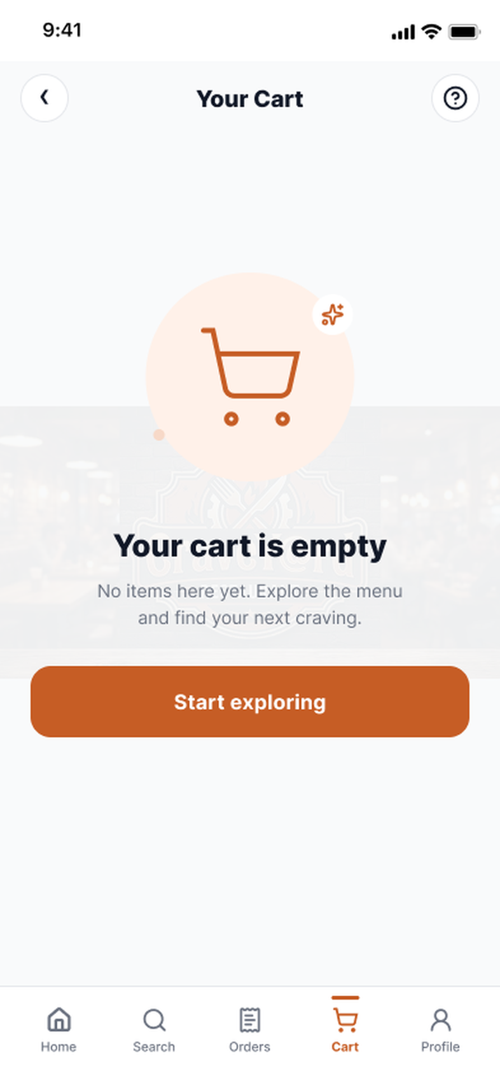



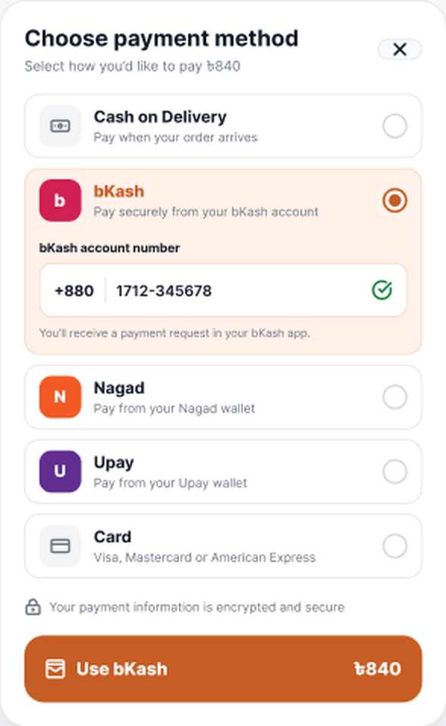
PART 2 • FUYAD • 1 OF 2
Workflow / Prototype in a Glimpse
From the home screen to payment: how a guest or student moves through the prototype. Continues on the next slide.
BROWSE & CUSTOMIZE
View all
Pick a category
Open restaurant
Select a dish
Home
Food categories
Search
Restaurant menu
Item details
CART & CHECKOUT
Add to Cart
Remove items
Checkout
Log in or guest
Change payment
Empty cart
Cart
Login or guest
Checkout
Payment method
Notes:
A quick map of the first half of the prototype. The arrows show which button or action leads to the next screen. Browsing and cart building work for guests; login is only asked at checkout. The empty cart is the state after removing items.

Slide 9


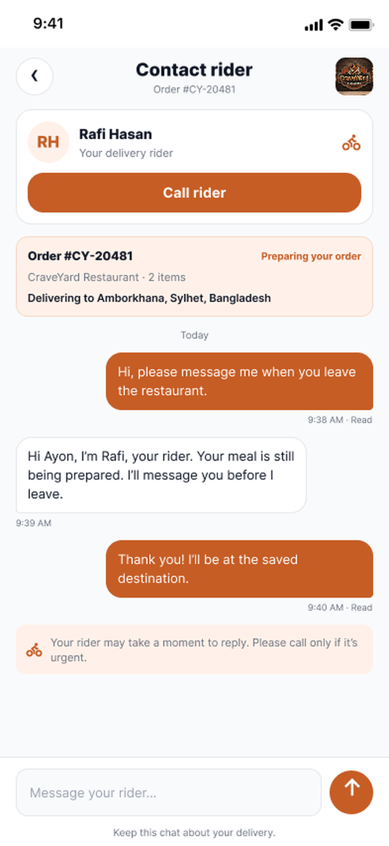
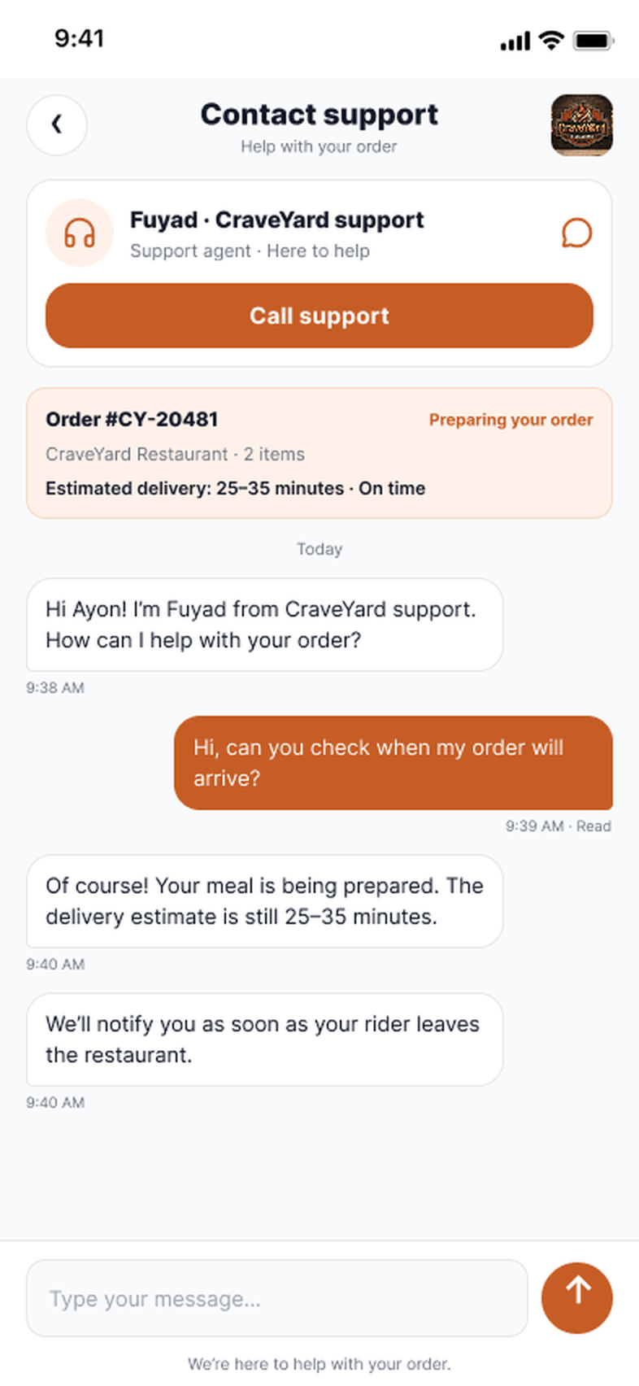

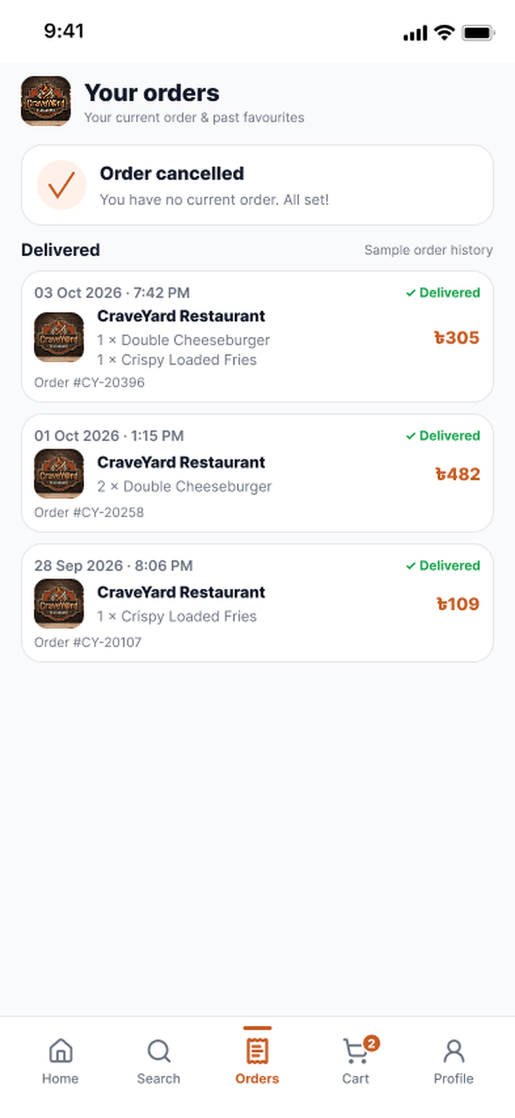
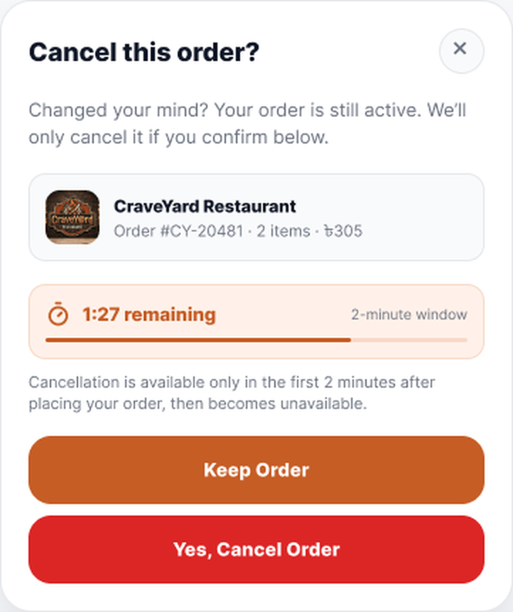
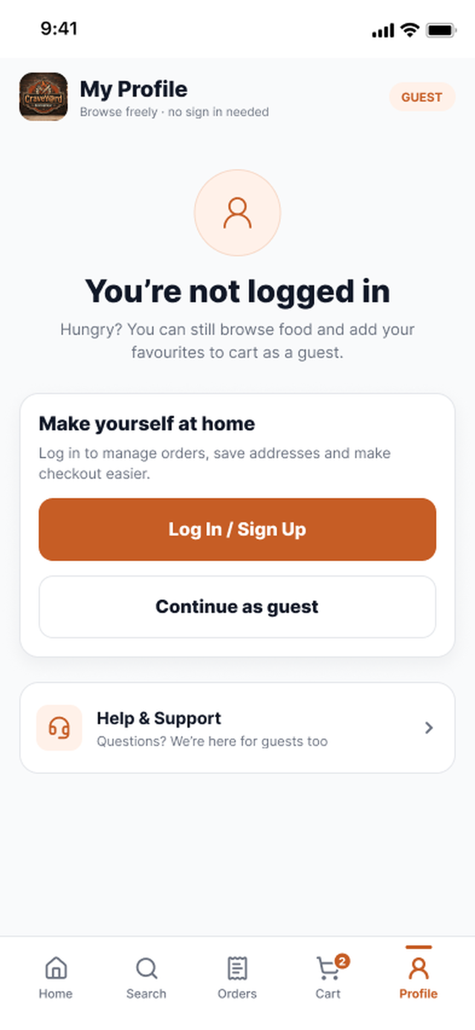
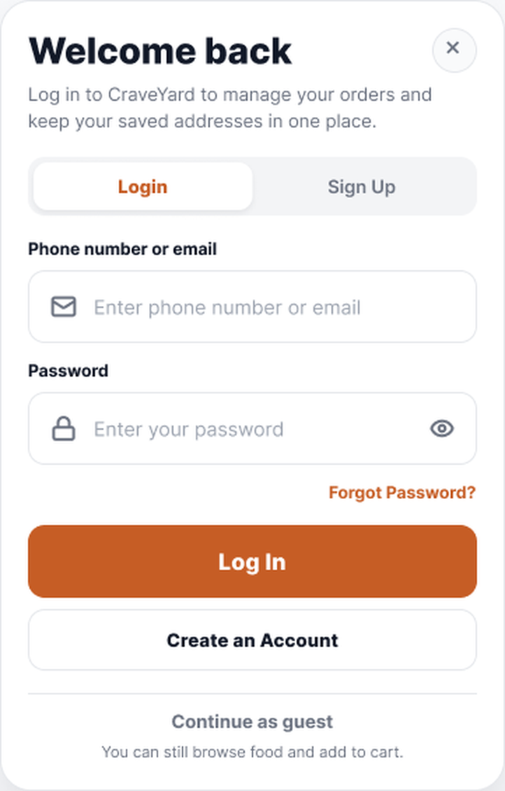
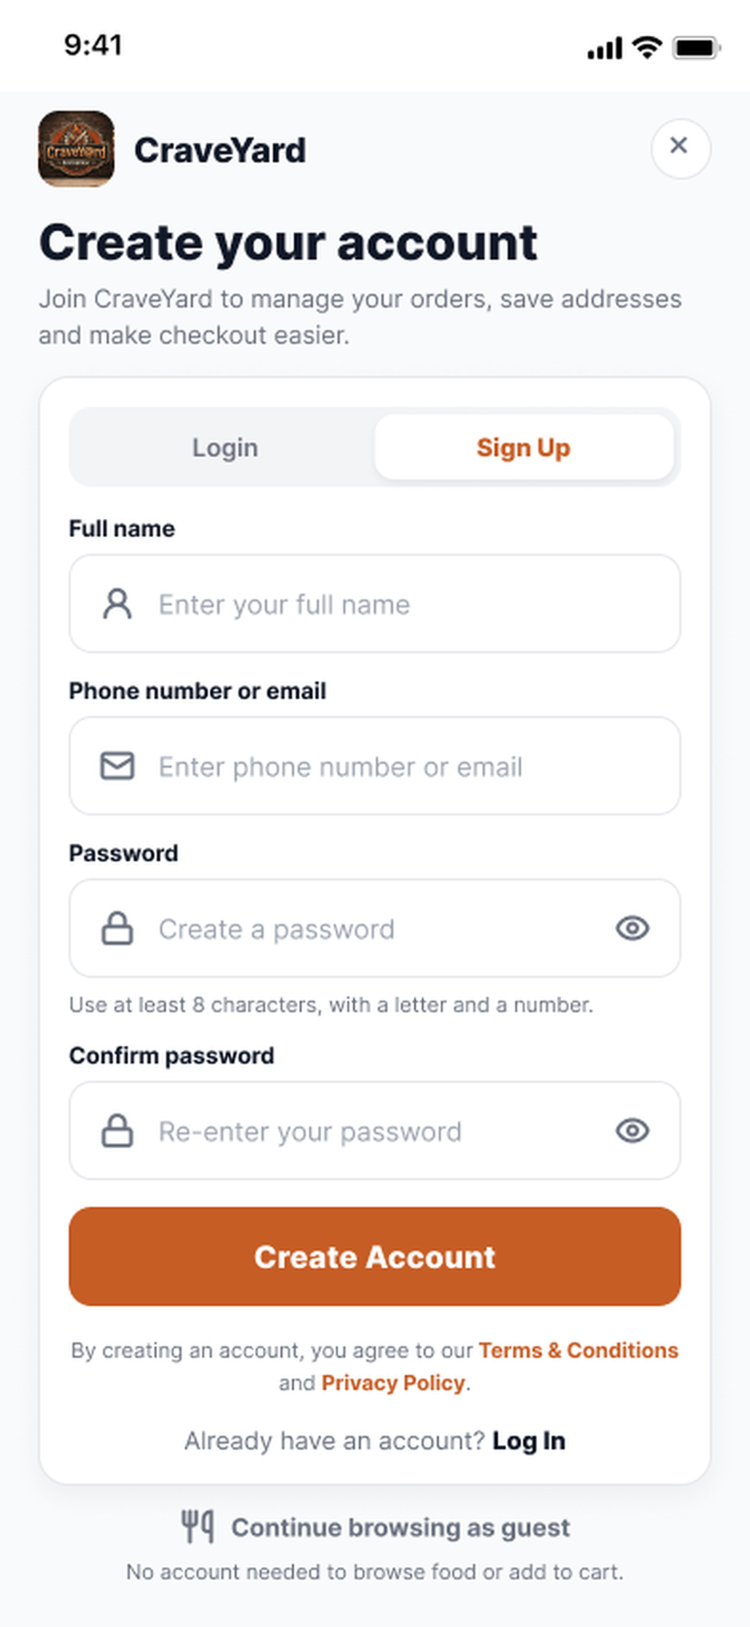
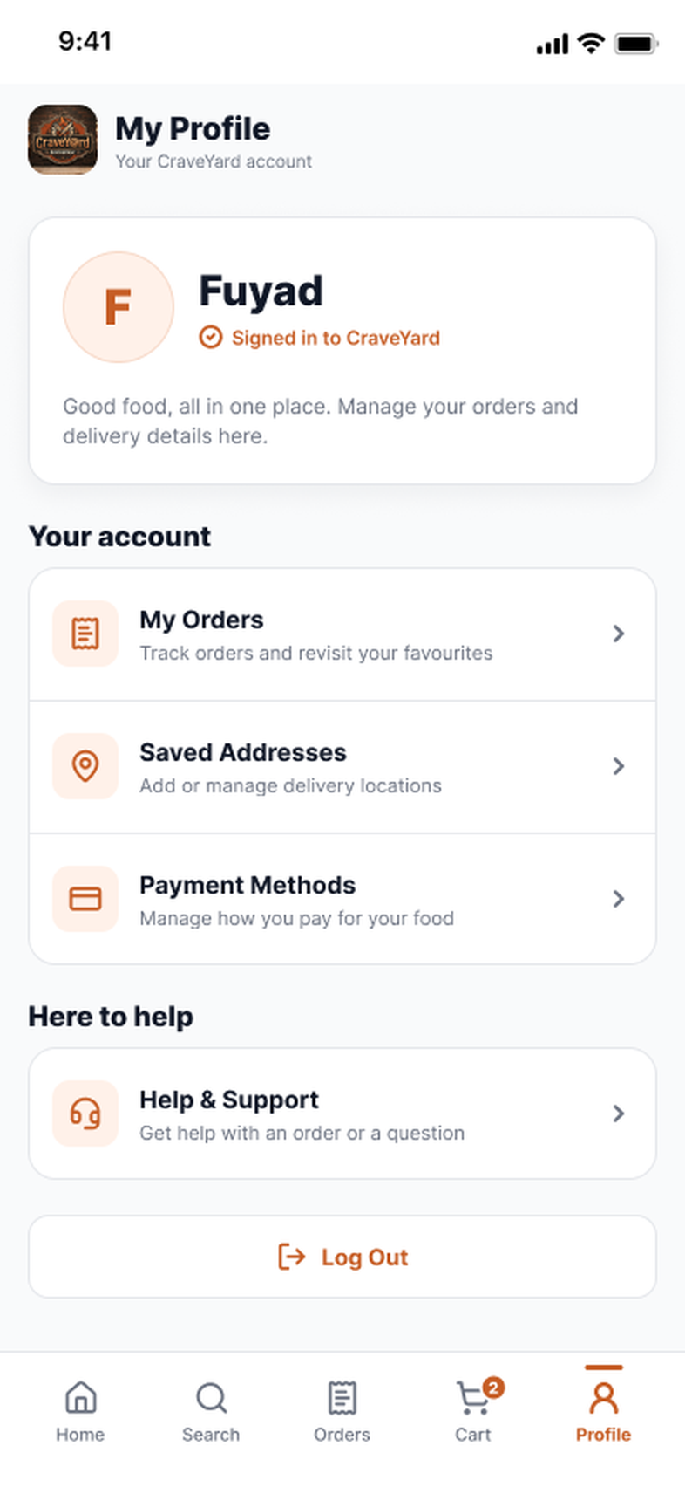

PART 2 • FUYAD • 2 OF 2
Workflow / Prototype in a Glimpse
After Place Order: confirmation, tracking, support and cancellation, then the account screens.
TRACK & CONTACT
Need help?
CANCEL WINDOW
Track Order
Contact rider
Cancel
Confirm
Order confirmed
Track order
Contact rider
Contact support
Current order
Cancel this order?
Order cancelled
ACCOUNT
Log In / Sign Up
Create an Account
Create Account
Saved Addresses
Profile (guest)
Log in popup
Sign up
Profile (logged in)
Edit address
Notes:
Second half of the prototype. After placing an order the student sees a confirmation, can track the order and contact the rider or support, or cancel within the 2-minute window. The bottom row shows the account path from guest profile to login or sign-up, and then saved addresses.

